Slide 1
Indoor Localization system using Time of Flight in UWB spectrum
Anirban Ghosh
Albert Davies
Tejus Siddagangaiah

Slide 2
Objective
Compute a mobile node’s position with respect to multiple anchor nodes in an indoor setting

Slide 3
Methodology
Texas Instrument’s CC3200 + Decawave’s DWM1000 UWB module
Explain both?
What do we put in the demonstration section ?
I don’t know what he means by Use Cases? Should we explain what the demos would look like?

Slide 4

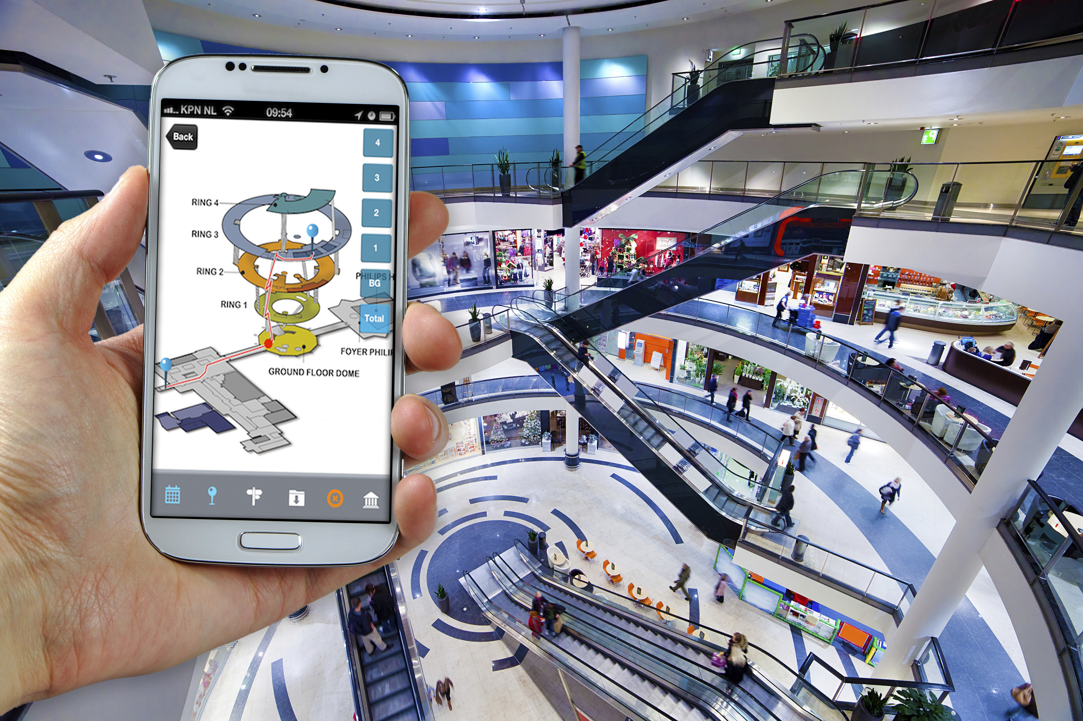

Application and Use Cases
Indoor Localization systems can be developed and applied to any large venue: Shopping Malls, Airports, Universities, etc.
Indoor Localization systems can be used for to provide directions, provide relevant advertisement, raise requests for help, etc.
Similar localization systems can also be used in remote environments like coal mines to track people
Image source: Google

Slide 5
System Architecture and Design
Admin System
PC/Laptop
CC3200 SoC
Cortex-M4 Core
80MHz
Network Processor
Decawave
DW1000 Module
WiFi
SPI
Peripherals and Power Management
CC3200 SoC
Cortex-M4 Core
80MHz
Network Processor
Decawave
DW1000 Module
SPI
Anchor Node - I
Peripherals and Power Management
Mobile Node
CC3200 SoC
CC3200 SoC
Cortex-M4 Core
80MHz
Network Processor
Cortex-M4 Core
80MHz
Network Processor
Decawave
DW1000 Module
Decawave
DW1000 Module
SPI
SPI
Peripherals and Power Management
Peripherals and Power Management
Anchor Node - III
Anchor Node - II

Slide 6
System Diagram of a Node
CC3200 SoC
Cortex-M4 Core
80MHz
Network Processor
Decawave
DW1000 Module
SPI
Peripherals and Power Management

Slide 7
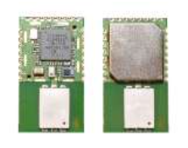
DWM1000 Module and it’s working
DWM1000 Modules can be used in two modes:
2 – way ranging (Time of flight): Configure the modules to time-stamp packets exchanged between two nodes and find the distance between them
Time Difference of Arrival(TDOA) : Configure multiple modules to transmit beacons at regular intervals of time to check the relative time of arrival of the packets at the mobile nodes

Slide 8
Demonstration Milestones
Mid-term demonstration: Establish the point-to-point communication between two nodes and calculate the distance between the two nodes
Final demonstration: Use multiple anchor nodes whose locations are pre-determined to track the mobile node in the same environment. Display the movement of the mobile node on a GUI(using a PC application) in real time

Slide 9
Drawbacks and challenges of our approach
Scalability:
Time of Flight algorithm can be used to locate a mobile node in the environment accurately. However, this system cannot be scaled when the number of mobile nodes increase
As the number of nodes increase, the load on each anchor node increases as they have to communicate between all the mobile nodes
Approach to solve the scalability issue: Use TDOA
Error due to difference in clocks of each node:
The difference in time across multiple nodes due the clock skew cannot be determined. A small error in time-stamping can lead to large precision errors of the location of mobile nodes
Solution: Crystal Oscillator trimming feature provided by the DWM1000 modules

Slide 10
Questions?

